Slide 1


Research presentation:
High performance silicon AWG with geometrically improved interface between slab and waveguide array
Tsuda Hiroyuki’s Laboratory
Santacatterina Simon
School of integrated design engineering
81923479

Slide 2
Agenda
Introduction
​
Aim of research
Research method and results
Conclusion

Slide 3
Introduction

Slide 4

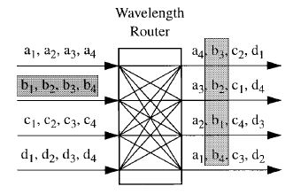
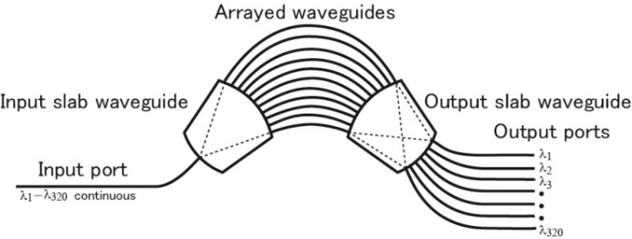
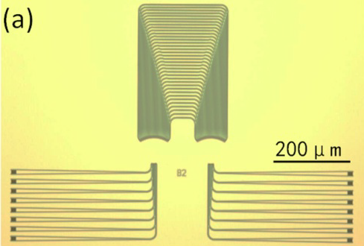
Framework of AWGs
Issues
One of the most used photonic component in optical networks : increase capacity of transmission and flexibility
Optical wavelength de/multiplexer
Compact device, single-mask planar waveguide technology
At first in Silica, now being developed using Silicon to increase integration density and performances
Appli.
modulator, photodiode, WDM device, optical coupler/splitter
1.
5.
4.
2.
3.
Demultiplexing
Data center
Router in Optical networks
Multiplexing
Si single mask

Slide 5
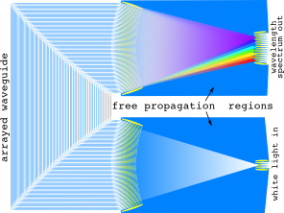
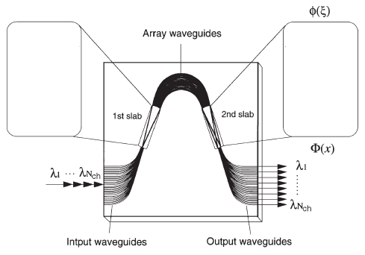
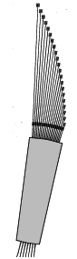
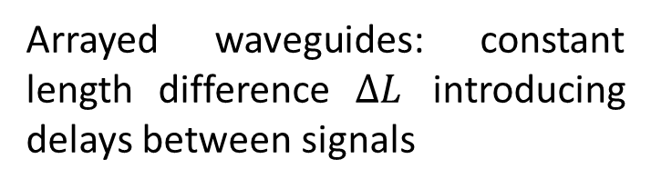

Physical characteristics
Structure:
Physical principles:
1st slab: diffraction of input signal, copy to each arrayed waveguides
8.
IN
$$i∗ΔL$$
Arrayed waveguides: constant length difference $ΔL$ introducing delays between signals
Many signals
One signal
7.
Section view of AWG
6.
2nd slab: interference of beams
Spatial division of wavelength
8.
OUT

Slide 6
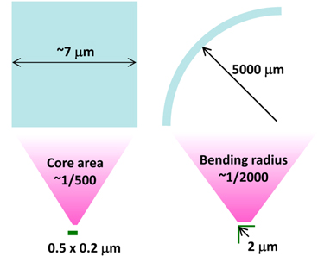




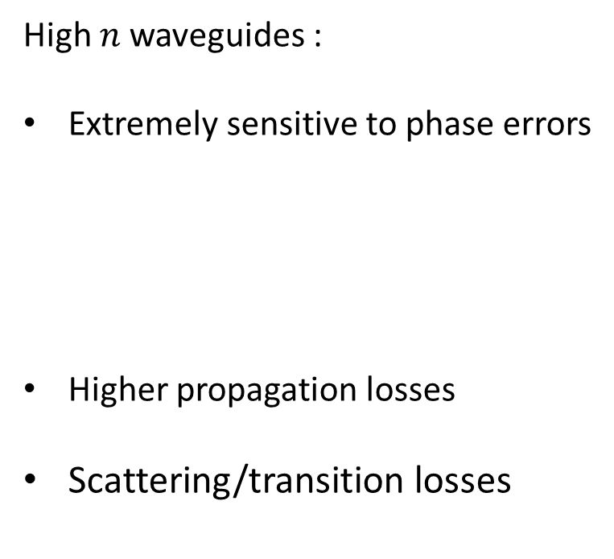


Silicon photonics
Guiding mechanism
Drawbacks
$$θ_{r_max}=\cos^{−1}(n_{clad}/n_{core})$$
with
Better waveguiding mechanism for Silicon
High $n$ waveguides :
Extremely sensitive to phase errors
Higher propagation losses
Scattering/transition losses
$$n_{Si}=3.47, n_{{SiO}_{2}}=1.44 , n_{{Ge−SiO}_{2}}=1.45$$
Optical confinement
TIR : total internal reflection
High index core $n_{core}$
$$k_{z}$$
Reduce margin of error of both the design and fabrication
$$k=2πn_{core}/λ$$
$θ_{r}$
E or H
Miniaturization
Low index cladding $n_{clad}$
TIR
z
Increase the overall crosstalk
Core area 500 times smaller
Bending radius 2000 times smaller
Increase integration density
Compact : energy efficient
CMOS compatible and robust
Increase the overall crosstalk
9.

Slide 7
Aim of research

Slide 8
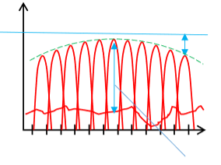
Goal : High performance Si AWG
By reducing:
Loss
Loss variation
Crosstalk
Introducing new modifications
Optimization methods
Method
Input level
output
Loss
Transmission
Loss variation
Wavelength
10.
Physical quantities representation
Crosstalk

Slide 9
Research Method

Slide 10
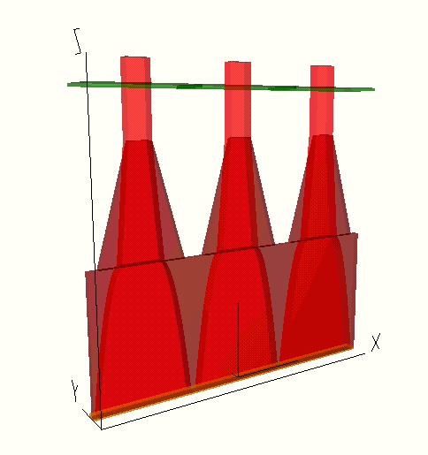
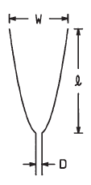
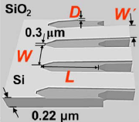
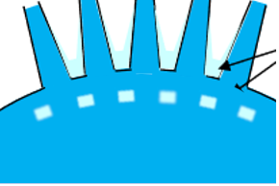
Proposal of new AWG structure
New taper structure : 2 stages
Background
Adiabatic transition
New improvements
6.
11.
Slab etching and parameters optimization
Tapers
Etching
Etched regions
Smoother transition
d
Tapers : mode-size converter to reduce planar waveguide and single mode waveguide mismatching
l
w
Etching : suppressing multimode generation and the scattering due to the optical field mismatch effect
10.
Wavefront Matching Method (WMM)

Slide 11
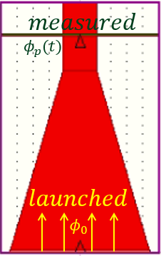


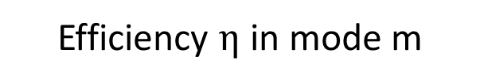
Measurement setup and metrics
Geometrical Setup
Metrics
Crosstalk
Power
Efficiency $η$ in mode m
measured waves
*
*
Z
Optimize for fundamental mode
(Overlap integral)
Power S(t) crossing the measurement site
X
Y
*
launched wave
Compute Crosstalk and Loss
*Measurement planes in green in following slides

Slide 12
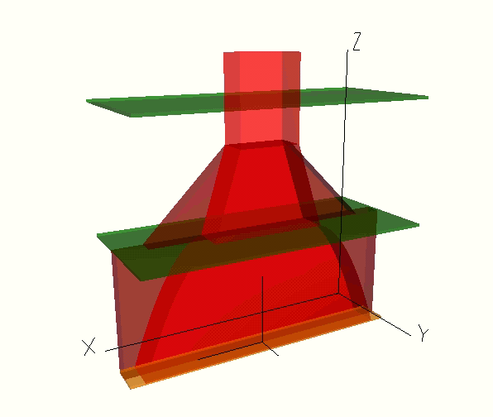
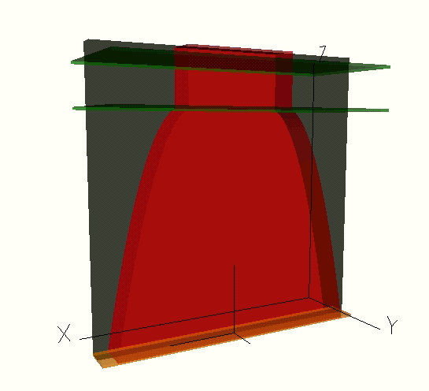
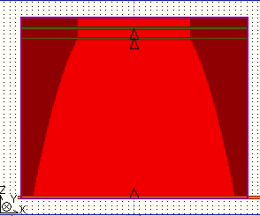
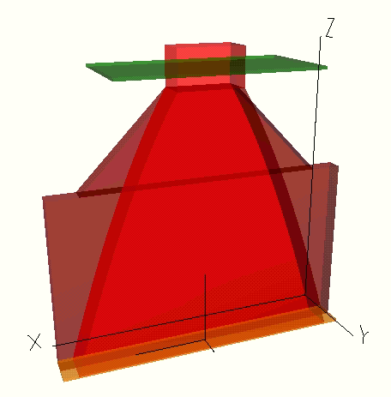
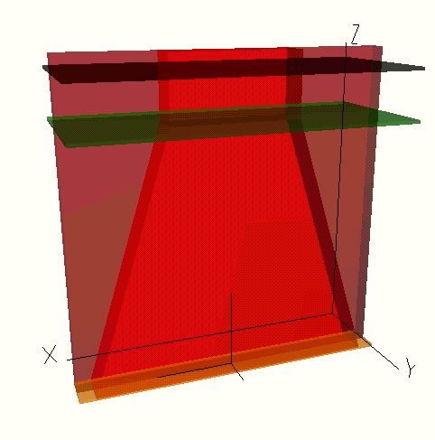
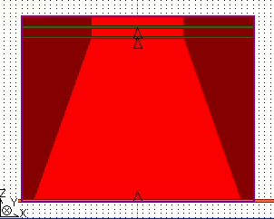
Taper two stages optimization
2nd stage of optimization
1st stage of optimization
Parabolic
2 STAGES
3D view
2D view
Lrib
Rib
d
L
d
Taper
L
L
Linear
3D view
2D view
COMBINED
Taper + Rib
L + Lrib
L
L

Slide 13
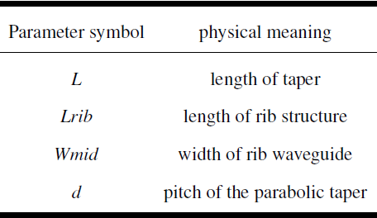


Taper two stages optimization (cont.)
Global 2 stage taper structures
Optimization parameters :
Wout
Lrib
Wmid
Gap
Fixed:
Taper input width (Win)
Single mode waveguide width (Wout)
Gaps
L
d
Win
Gap

Slide 14
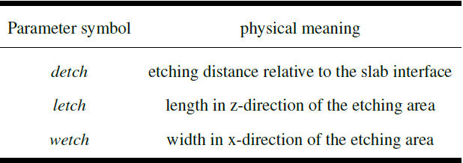
Etching optimization
Slab etching
Artistic view
Optimization parameters :
Etched regions
d
l
w
10.
Layout Y-cut
Find detch, letch and wetch by maximizing the metrics under minimum resolution constraints

Slide 15
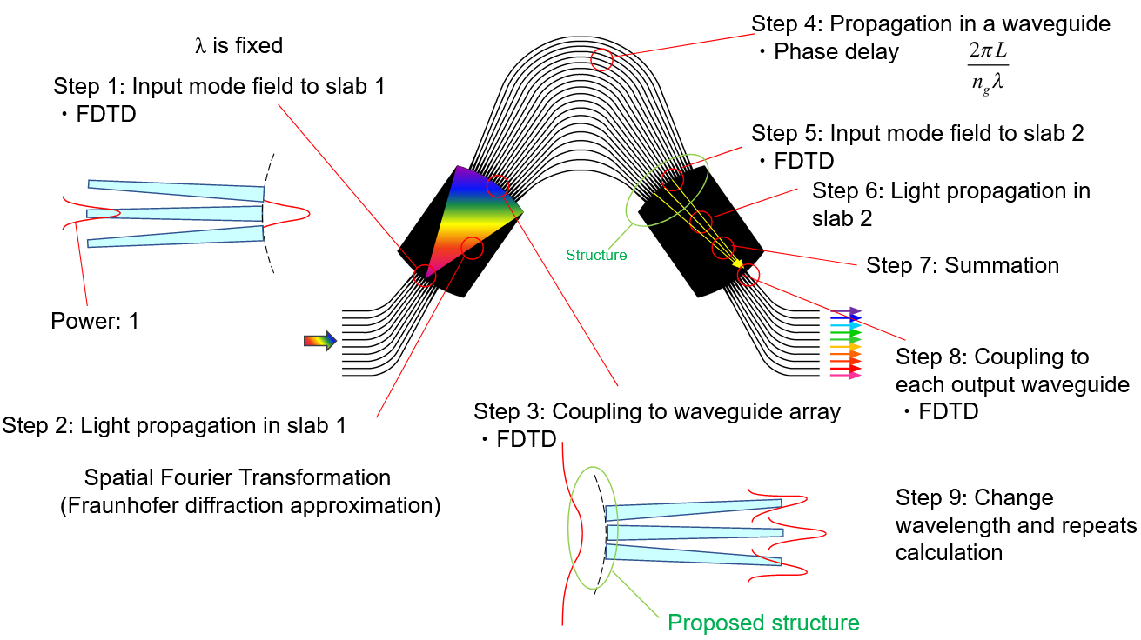
Overall AWG characteristics
9 steps including:
FullWave FDTD
Fourier transform
Custom algorithm

Slide 16
Simulation and Results

Slide 17
First stage : Taper optimization
3D FDTD Overlap data
Parabolic
Better Transmission
Linear
Parabolic
orange measurement plane
blue measurement plane
Various value of L gives a maximum for the overlap function
Longer linear taper does not improve the transmission

Slide 18
First stage : Taper optimization
Taper length is optimized to give better output characteristics for various Wmid (0.8um, 1um)
Parabolic taper’s slope d can be tuned to improve the overlap and power at the output
Parabolic taper exhibits better characteristics than linear tapers
Smaller d is better
First stage is optimized with :
L = 2.8um
d = 0.1
Parabolic taper
Wmid = 1um
Various value of L gives a maximum for the overlap function
Longer linear taper does not improve the transmission

Slide 19
Optimal value
Second stage
Second stage optimized in the same way, given first stage best L, d, Wmid and parabolic:
2 stages
Combined
Second stage is optimized with :
Lrib = 2um
Wmid = 1um
2 stage is better than combined structure

Slide 20
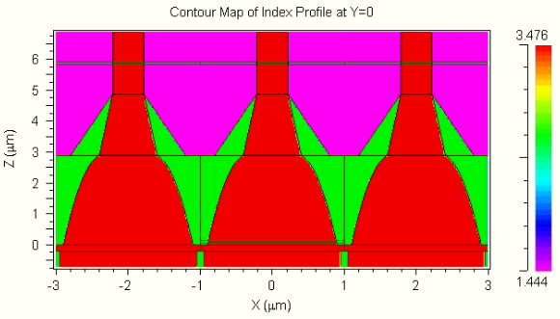
Slab etching : 3 parameters optimization
Index profile showing simulated interface
3D FDTD simulations: higher power intensity
Etchings

Slide 21
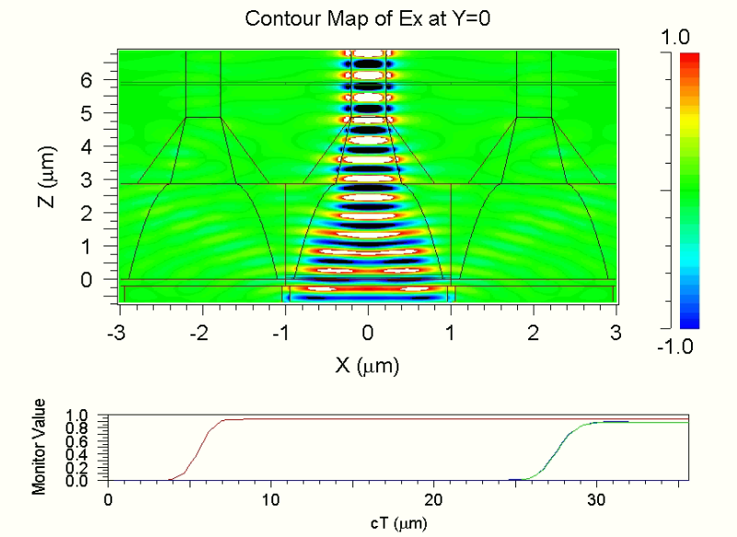
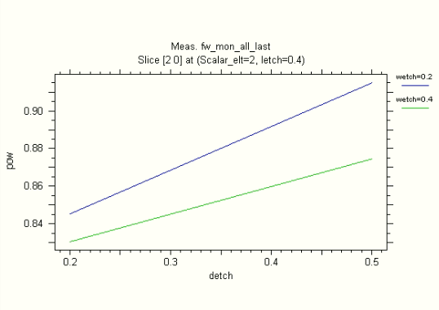
Slab etching : 3 parameters optimization
Optimal design output
Power through monitors
Optimized with :
letch = 0.4um
detch = 0.5um
wetch = 0.2um
Values:
Crosstalk = -26 dB
Loss = 0.3 dB
Launched Power
Output Power

Slide 22
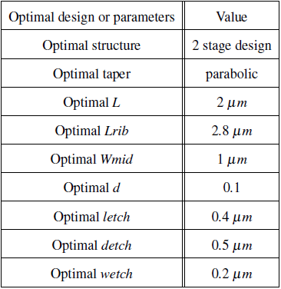
Final values

Slide 23
Overall AWG characteristics results
9 steps including:
FullWave FDTD
Fourier transform
Custom algorithm

Slide 24
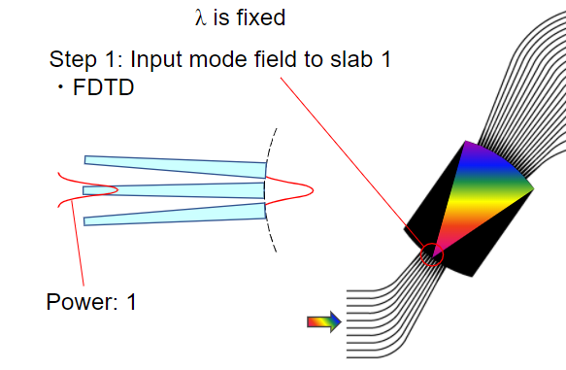
Input beam
Input
Input beam after taper
Solving mode by FEM
Launching at input waveguide
FDTD computation
FPR input beam

Slide 25
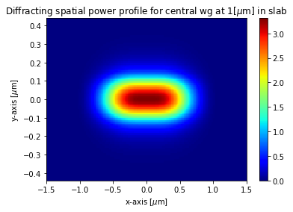
First FPR : diffracting beam
Diffraction direction
Beam diffraction along x-axis in first FPR
Enclosed direction
Fraunhofer diffraction
Slab enclose beam y-axis in first FPR

Slide 26
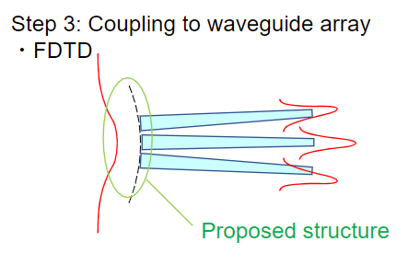
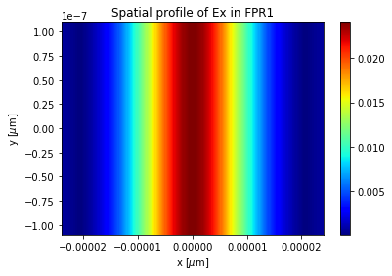
Coupling to Array
y-axis
x-axis
Diffracted beam reaches waveguide array
Measuring profile

Slide 27
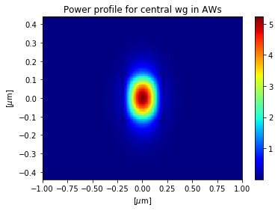
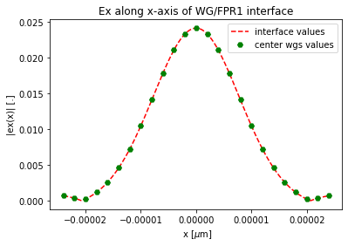
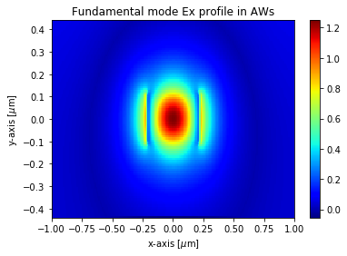
Arrayed Waveguides
Power and Ex in each waveguide
Field sampled by the waveguide array

Slide 28
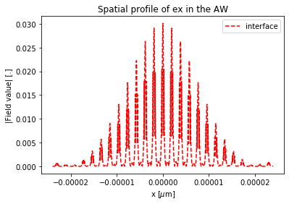
Arrayed Waveguides (cont.)
Field sampled by the waveguide array

Slide 29
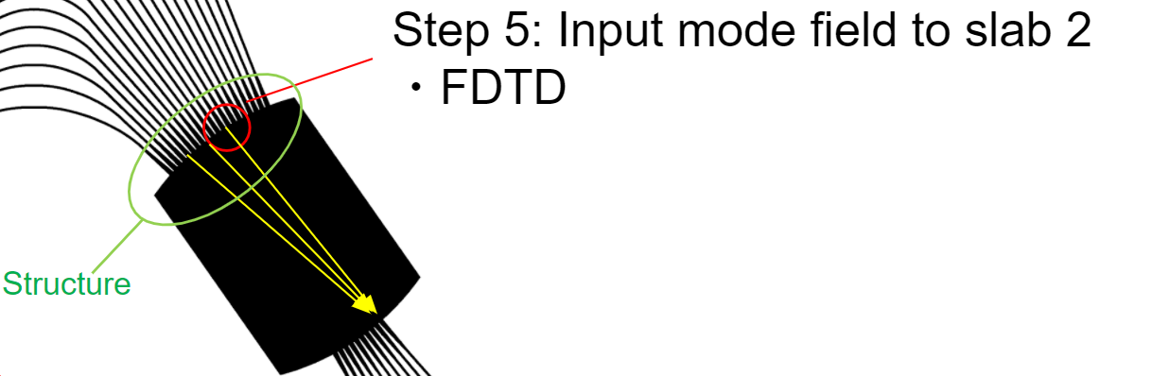
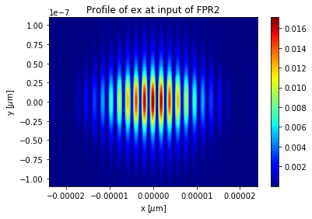
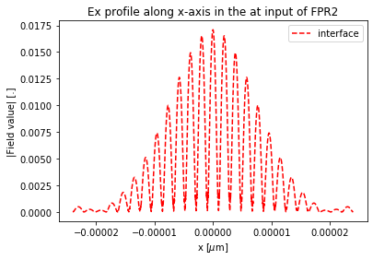
Second FPR input
Taper diffract AWs beams
FDTD computation
FPR input beam

Slide 30
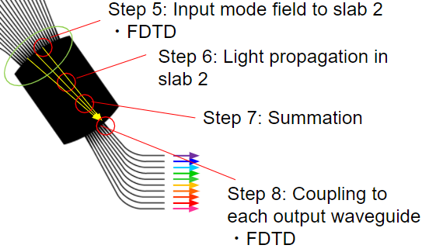
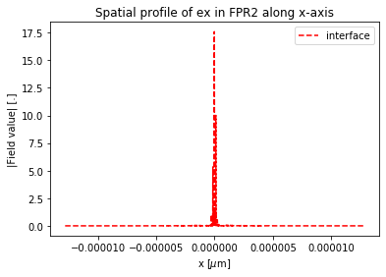
Second FPR
FPR2 summed diverging beam
Step 6 & 7
Step 8
Diverging beams summed
Coupling to output wgs
Repeat process

Slide 31
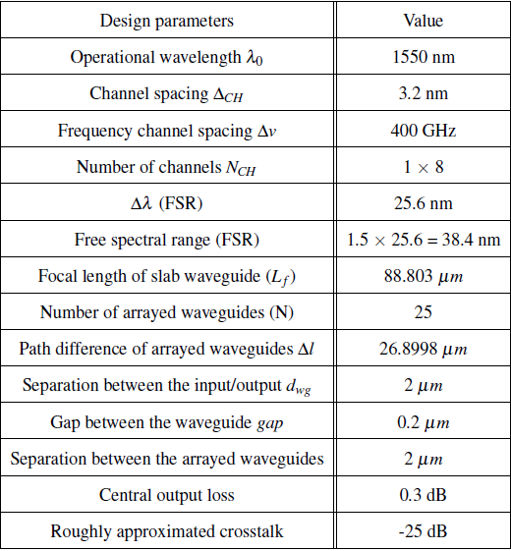
Final values

Slide 32
Conclusion

Slide 33
Conclusion
1st optimization using tapers design
2nd optimization by etching in the slab
Overall AWG characteristics computed

Slide 34
Thank you

Slide 35
References
Cisco Global Cloud Index, 2016-2021.
An Overview on Traditional Data Center Outsourcing Service Providers, https://www.isg-one.de/research/articles/an-overview-on-traditional-data-center-outsourcing-service-providers?searchTerms=service+providers, Shashank Rajmane.
Meint K. Smit and Cor van Dam, “PHASAR-Based WDM-Devices: Principles, Design and Applications”, IEEE Journal of selected topics in quantum electronics, Vol. 2, No. 2, June.
Dong-Hak Choi, Hideaki Hiro-Oka, Kimiya Shimizu, Kohji Ohbayashi, “Spectral domain optical coherence tomography of multi-MHz A-scan rates at 1310 nm range and real-time 4D-display up to 41 volumes/second”, December 2012, Biomedical Optics Express 3(12):3067-86.
Tong Ye, Yunfei Fu, Lei Qiao, and Tao Chu, “Low-crosstalk Si arrayed waveguide grating with parabolic tapers”, Optics Express 31899, Vol. 22, No. 26, 29 Dec 2014.

Slide 36
References
Christopher Richard Doerr and Katsunari Okamoto, “Advances in Silica Planar Lightwave Circuits”, Journal Of Lightwave Technology, Vol. 24, No. 12, December 2006.
Katsunari Okamoto and Kenzo Ishida, “Fabrication of silicon reflection-type arrayed-waveguide gratings with distributed Bragg reflectors”, Optics Letters, Vol. 38, No. 18, September 15, 2013
http://photonics.intec.ugent.be/research/topics.asp?ID=132, Ghent University research team on AWG, main researcher : Shibnath Pathak.
Koji Yamada, Tai Tsuchizawa, Hidetaka Nishi, Rai Kou, Tatsurou Hiraki, Kotaro Takeda, Hiroshi Fukuda, Yasuhiko Ishikawa, Kazumi Wada and Tsuyoshi Yamamoto, “High-performance silicon photonics technology for telecommunications applications”, Science and Technology of Advanced Materials, Vol. 15, No. 2, 23 April 2014.
Tsuda Hiroyuki, Keio University.
Jaegyu park, Gyungock Kim, Hyundai Park, Jiho Joo, Sanggi Kim, and Myung-Joon Kwack, “Performance improvement in silicon arrayed waveguide grating by suppression of scatteringnear the boundary of a star coupler”, Applied Optics, Vol. 54, No. 17, June 10, 2015

